Slide 1

RTOS Concepts
Response Time and Jitter
http://www.chibios.org

Slide 2
Jitter and Time Scale
There is always Jitter, a good RTOS design limits the intrinsic Jitter in the system
“Fast” is not necessarily relevant, what matters is the worst case not the best case
An RTOS should be evaluated using the time scale of the events it can handle, this time scale is a function of Jitter

Slide 3
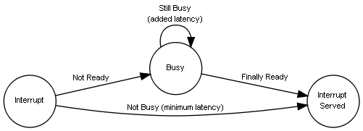
Interrupt Latency
Probably one of the most important parameters to consider in embedded systems is the jitter associated to interrupts servicing:
In this scenario the jitter (busy state) is represented by the sum of:
Hardware intrinsic latency
Higher or equal priority interrupt handlers execution time combined. This time can go from zero to the maximum randomly. This value can be guaranteed to be zero only if the interrupt has the highest priority in the system.
Highest execution time among lower priority handlers. This value is zero on those architectures (Cortex-M3 for example) where interrupt handlers can be preempted by higher priority sources.
Longest time in a kernel critical section that can delay interrupt servicing.

Slide 4
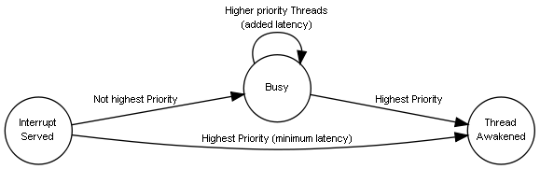
Threads Fly-Back Time
The Fly-Back time is the time between an event, for example an interrupt, and the execution of the thread that will process it and perform the programmed reaction. Imagine the following graph as the continuation of the previous one:
In this scenario all the jitter sources previously discussed are also present and there is the added jitter caused by the activity of the higher priority threads.
The total response time jitter is a function of all the interrupt sources in the system and the relative priority of software threads in addition to the intrinsic jitter caused by the operating system critical zones.

Slide 5
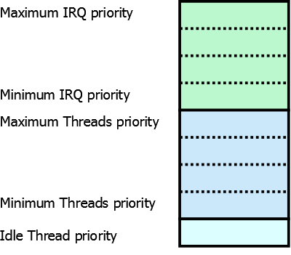
Interrupts and Threads
In order to simplify the analysis we may consider ISRs as a special kind of Threads operating on an higher priority range.
ISRs can be seen as a special kind of threads. The only limitation compared to normal Threads is that an ISR cannot go in a sleep state.
The idle Thread is executed only when there are no other Threads ready for execution, it is placed at the lowest priority level.

Slide 6

End

